Slide 1
Unit 10: Physical Activity for Individual and Group-Based Exercise
BTEC Level 3 (RQF) Sport and Exercise Science
2020-21

Slide 2
Your lesson is being recorded

Slide 3
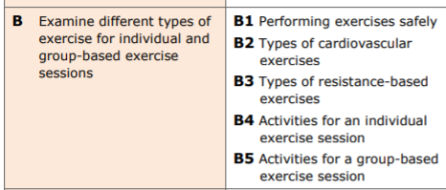
Task B – Learning Aims:

Slide 4
Learning Outcomes:
Identify a variety of components that must be considered to perform exercises safely.
Explain a variety of components that must be considered to perform exercises safely.
Analyse a variety of components that must be considered to perform exercises safely.

Slide 5
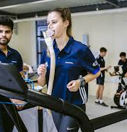
The “Warm up”
What is a warm up?
What is the purpose of a warm up? (physiology)
Discuss and feedback

Slide 6
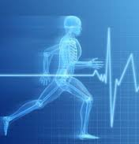
The Warm Up (Jeffreys, 2006)
‘A warm up provides a smooth transition from resting state to a state of athletic readiness’ (Crossley, 2012; pp. 26)
Involves a period of preparation which includes activities for:
Joints (mobility)
Muscle Groups (activation)
Cardio-respiratory system
CNS

Slide 7
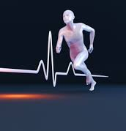
The ‘R-A-M-P’ Approach (Jeffreys, 2006)
Raise – elevate core body temperature, heart rate, joint viscosity
Activate – activate key muscle groups and muscle fibre types (e.g. Type 11x in a long-jump warm up)
Mobilise – mobilise key joints and ranges of motion used in the sport (e.g. Overhead squats for the snatch)
Potentiation – increasing the intensity of exercise to a point that athletes are able to perform at their maximal levels – often referred to as PAP
https://www.atletiekunie.nl/sites/default/files/userfiles/thema/themadagen/looptrainersdag/2018/Handouts/Plyometrie%20Artikel%202%20-%20Nout%20van%20der%20Velden.pdf

Slide 8
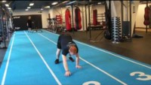
Raise

Slide 9
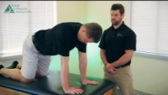
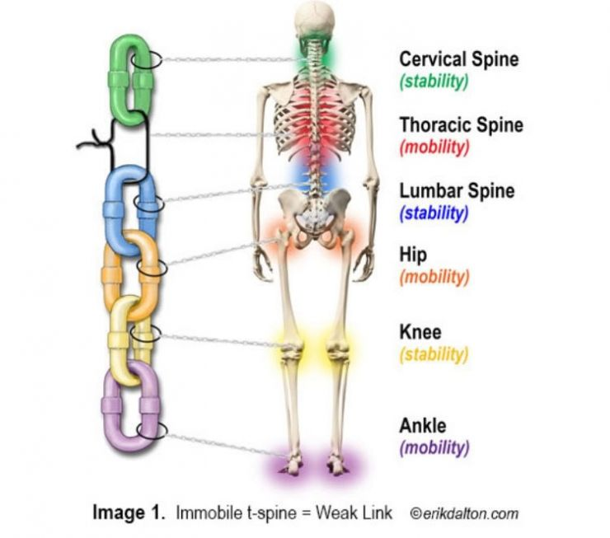
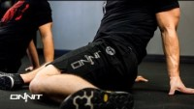
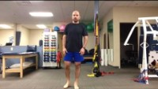
Activate and Mobilise

Slide 10
Potentiation Exercises

Slide 11
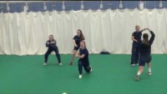
RAMP – Warm Up

Slide 12
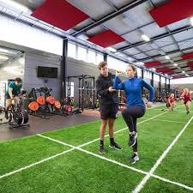
What is the purpose of warming up?
Discuss as a group (use MS Teams chat)
To reduce the risk of musculoskeletal injury
To improve performance as a whole
Increased neural readiness – speed and force of muscle contraction and activation
Increase core body temperature
Other physiological responses?

Slide 13
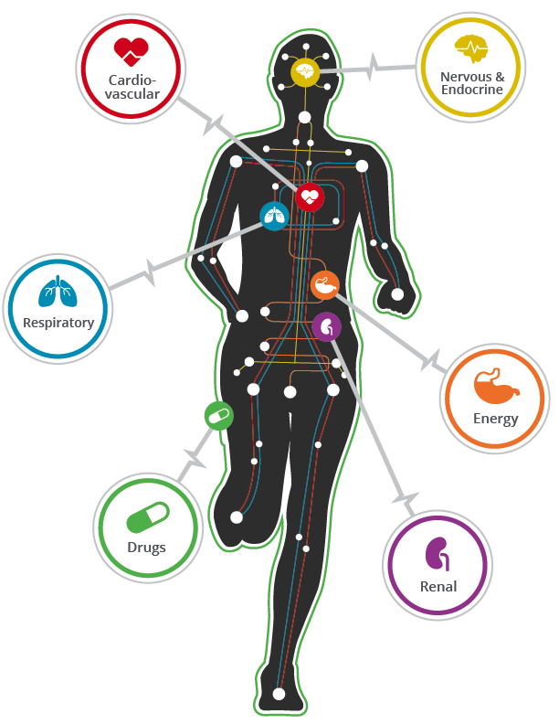
General Components of a Warm Up
Pulse Raiser
- 5 minutes with incremental increase in intensity
- Raise core body temperature/respiratory rate
- Can be monitored using RPE/MHR%
- Intensity is dependent on athlete’s ability

Slide 14
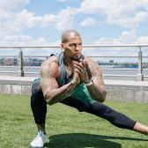
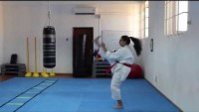
Pre-Stretches
The type of stretch will depend on the activity/sport
E.g. ballistic stretching may be used for explosive movement patterns such as javelin/discuss
What type of stretches might be used in a warm up for your sport? Why?

Slide 15
Types of Stretches
BALLISTIC STRETCHING
MOMENTUM GENERATED BY USING A ‘’BOUNCING’’ MOTION
USED TO ACTIVE FAST-TWITCH FIBRES TO FACILITATE EXPLOSIVE MOVEMENT
HIGH RISK, HIGH REWARD
Static Stretching
Controlled and slow movements which elongate the muscles to provide elasticity.
Prevent muscle soreness
Hold for 20-30 seconds
It is important to implement stretches that are relevant to the physiological demands of the sport
Always consider the athlete’s current abilities (e.g. previous injuries)
How can you make the stretches sports-specific?
Pnf STRETCHING
Stretch is ‘’facilitated’’
assisted stretching – often requires a partner
‘’Contract-relax-contract’’ technique – PASSIVE!
Dynamic STRETCHING
Active stretches whereby joints go through full range of motion.
Often mimic the activity you’re about to perform
Involve movement e.g. leg swings

Slide 16
Why Stretch?
Preparation stretches:
Reduce the risk of injury
Increase performance
Post-Activity Stretches:
Eliminate waste products
Reactivate neuromuscular responses
Release muscle tension

Slide 17
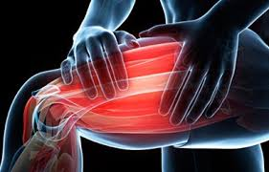
Key Term: Delayed Onset Muscle Soreness (DOMS)
Stress on connective muscle tissue (micro tears)
Muscle stiffness/pain generally occurs 12-72 hours after exercise
Has a relationship with the recovery phase of training – supercompensation occurs
Cool downs play a key role in reducing DOMS.

Slide 18
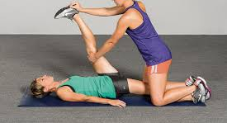
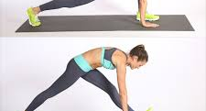
Implementing a Cool-Down (Crossley, 2012)
Provides a steady physiological transition from a working state back to a resting state.
Should consist of a general cardiovascular element (e.g. slow jog) which slowly decreases in intensity (HR Decreases)
Benefits:
Possible reduction of DOMS (typically felt 24-48 hours after training)
Improved removal of metabolic waste products after exercise (e.g. lactic acid)
Passive
Active

Slide 19
Practical Session – Next Week:
In groups of 2/3, plan the following:
10 minute warm up activity for a sport of your choice
10 minute cool down activity for a sport of your choice
You will deliver this to your peers.
Each group will feedback to those that have delivered.
Please use the resources provided in the lesson!

